Slide 1
Software Metrics and Estimation
Matakuliah Rekayasa Perangkat Lunak (CS215) – Gasal 2015/2016
Magister Ilmu Komputer - Universitas Budi Luhur
Achmad Solichin, S.Kom, M.T.I (achmatim@gmail.com)

Slide 2
Overview
Measure vs. Metrics
Measure and Metric Estimation Techniques
Metric Estimation Tools
Software Cost Estimation
COCOMO Model

Slide 3
Measure vs. Metrics
Measure
quantitative indication of extent, amount, dimension, capacity, or size of some attribute of a product or process.
Metric
quantitative measure of degree to which a system, component or process possesses a given attribute. “A handle or guess about a given attribute.”
Ex: Number of errors
Ex: Number of errors found per person hours expended

Slide 4
Why Measure Software?
Determine the quality of the current product or process
Predict qualities of a product or process
Improve quality of a product or process

Slide 5
Motivation for Metrics
Estimate the cost & schedule of future projects
Evaluate the productivity impacts of new tools and techniques
Establish productivity trends over time
Improve software quality
Forecast future staffing needs
Anticipate and reduce future maintenance needs

Slide 6
Example Metrics
Defect rates
Error rates
Measured by:
individual
module
during development
Errors should be categorized by origin, type, cost

Slide 7
Metric Classification
Products
Explicit results of software development activities
Deliverables, documentation, by products
Processes
Activities related to production of software
Resources
Inputs into the software development activities
hardware, knowledge, people

Slide 8
Product vs. Process
Process Metrics
Insights of process paradigm, software engineering tasks, work product, or milestones
Lead to long term process improvement
Product Metrics
Assesses the state of the project
Track potential risks
Uncover problem areas
Adjust workflow or tasks
Evaluate teams ability to control quality

Slide 9
Types of Measures
Direct Measures (internal attributes)
Cost
Indirect Measures (external attributes)
Functionality
Effort
LOC
Speed
Memory
Quality
Complexity
Efficiency
Reliability
Maintainability

Slide 10
Size-Oriented Metrics
Size of the software produced
LOC - Lines Of Code
KLOC - 1000 Lines Of Code
SLOC – Statement Lines of Code (ignore whitespace)
Typical Measures:
Errors/KLOC, Defects/KLOC, Cost/LOC, Documentation Pages/KLOC

Slide 11
LOC Metrics
Easy to use
Easy to compute
Language & programmer dependent

Slide 12
Complexity Metrics
LOC - a function of complexity
Language and programmer dependent
Halstead’s Software Science (entropy measures)
n₁ - number of distinct operators
n₂ - number of distinct operands
N₁ - total number of operators
N₂ - total number of operands

Slide 13
Example
if (k < 2)
{
if (k > 3)
x = x*k;
}
Distinct operators: if ( ) { } > < = * ;
Distinct operands: k 2 3 x
n₁ = 10
n₂ = 4
N₁ = 13
N₂ = 7

Slide 14
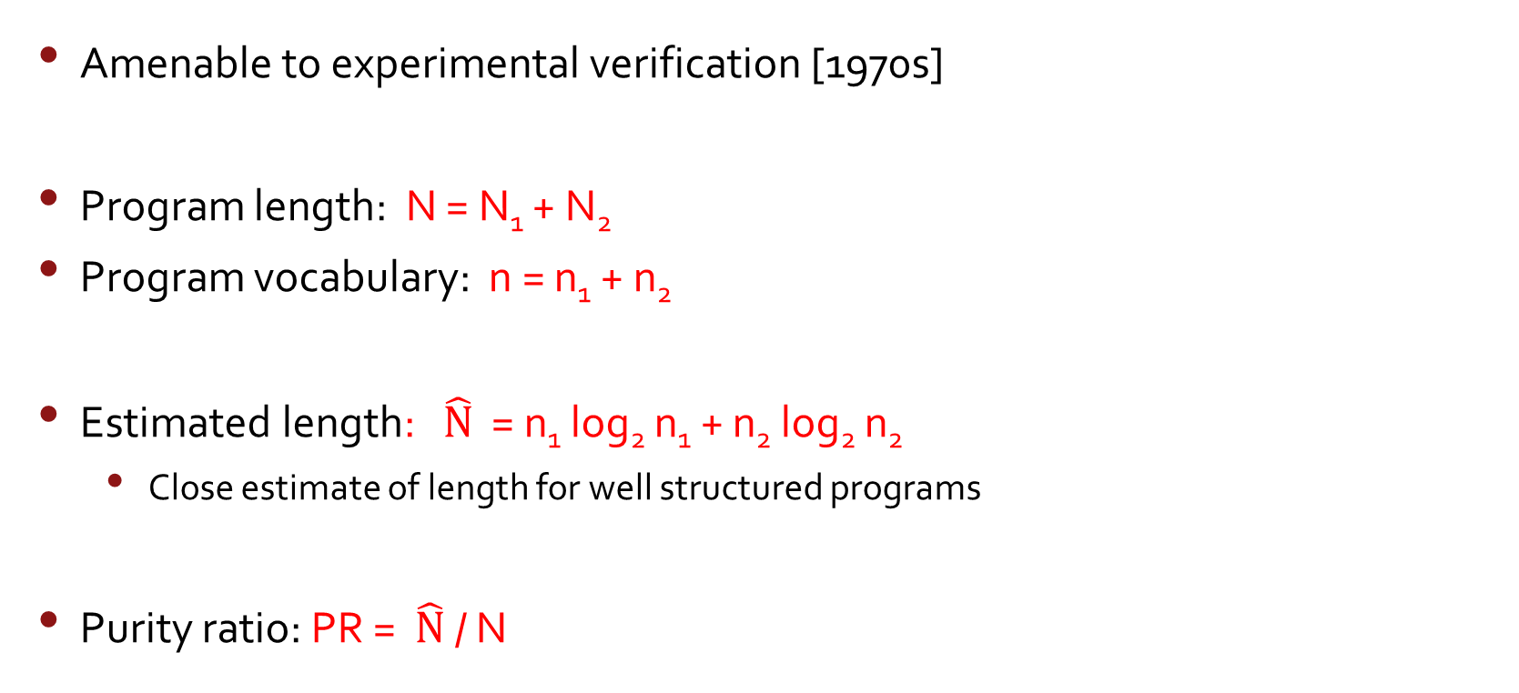
Halstead’s Metrics
Amenable to experimental verification [1970s]
Program length: N = N₁ + N₂
Program vocabulary: n = n₁ + n₂
Estimated length: $\hat{N}$ = n₁ log₂ n₁ + n₂ log₂ n₂
Close estimate of length for well structured programs
Purity ratio: PR = $\hat{N}$ / N

Slide 15
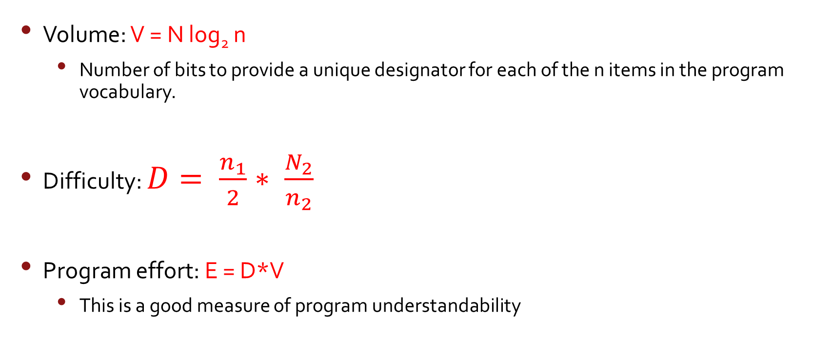
Program Complexity
Volume: V = N log₂ n
Number of bits to provide a unique designator for each of the n items in the program vocabulary.
Difficulty: $D= \frac{n_{1}}{2}∗ \frac{N_{2}}{n_{2}}$
Program effort: E = D*V
This is a good measure of program understandability

Slide 16
McCabe’s Complexity Measures
McCabe’s metrics are based on a control flow representation of the program.
A program graph is used to depict control flow.
Nodes represent processing tasks (one or more code statements)
Edges represent control flow between nodes

Slide 17
Flow Graph Notation
While
Sequence
If-then-else
Until

Slide 18
Cyclomatic Complexity
Set of independent paths through the graph (basis set)
V(G) = E – N + 2
E is the number of flow graph edges
N is the number of nodes
V(G) = P + 1
P is the number of predicate nodes

Slide 19
Example
1
i = 0;
while (i<n-1) do
j = i + 1;
while (j<n) do
if A[i]<A[j] then
swap(A[i], A[j]);
end do;
i=i+1;
end do;
2
3
7
4
5
6

Slide 20
Computing V(G)
V(G) = E – N + 2 = 9 – 7 + 2 = 4
V(G) = P + 1 = 3 + 1 = 4
Basis Set
1, 7
1, 2, 6, 1, 7
1, 2, 3, 4, 5, 2, 6, 1, 7
1, 2, 3, 5, 2, 6, 1, 7

Slide 21
Another Example
1
9
2
4
3
5
6
7
What is V(G)?
8

Slide 22
Meaning
V(G) is the number of (enclosed) regions/areas of the planar graph
Number of regions increases with the number of decision paths and loops
A quantitative measure of testing difficulty and an indication of ultimate reliability
Experimental data shows value of V(G) should be no more then 10 - testing is very difficulty above this value

Slide 23
McClure’s Complexity Metric
Complexity = C + V
C is the number of comparisons in a module
V is the number of control variables referenced in the module
decisional complexity
Similar to McCabe’s but with regard to control variables

Slide 24
Metrics and Software Quality
FURPS
Functionality – features of system
Usability – aesthesis, documentation
Reliability – frequency of failure, security
Performance – speed, throughput
Supportability – maintainability

Slide 25
Measures of Software Quality
Correctness – degree to which a program operates according to specification
Defects/KLOC
Defect is a verified lack of conformance to requirements
Failures/hours of operation
Maintainability – degree to which a program is open to change
Mean time to change
Change request to new version (Analyze, design etc)
Cost to correct
Integrity - degree to which a program is resistant to outside attack
Fault tolerance, security & threats
Usability – easiness to use
Training time, skill level necessary to use, Increase in productivity, subjective questionnaire or controlled experiment

Slide 26
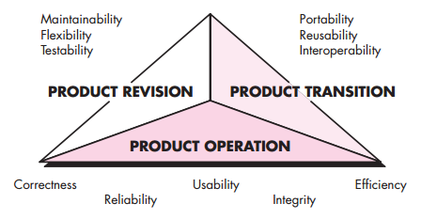
McCall’s Triangle of Quality

Slide 27
Quality Model
product
operation
revision
transition
reliability
efficiency
usability
maintainability
testability
portability
reusability
Metrics

Slide 28
High level Design Metrics
Structural Complexity
Data Complexity
System Complexity
Card & Glass ’80
Structural Complexity S(i) of a module i.
S(i) = f_{out}²(i)
Fan out is the number of modules immediately subordinate (directly invoked).

Slide 29
Design Metrics
Data Complexity D(i)
D(i) = v(i)/[f_{out}(i)+1]
v(i) is the number of inputs and outputs passed to and from i
System Complexity C(i)
C(i) = S(i) + D(i)
As each increases the overall complexity of the architecture increases

Slide 30
System Complexity Metric
Another metric:
length(i) * [f_{in}(i) + f_{out}(i)]²
Length is LOC
Fan in is the number of modules that invoke i
Graph based:
Nodes + edges
Modules + lines of control
Depth of tree, arc to node ratio

Slide 31
Coupling
Data and control flow
d_{i} – input data parameters
c_{i} input control parameters
d_{o} output data parameters
c_{o} output control parameters
Global
g_{d} global variables for data
g_{c} global variables for control
Environmental
w fan in
r fan out

Slide 32
Metrics for Coupling
M_{c} = k/m, k=1
m = d_{i} + ac_{i} + d_{o} + bc_{o} + g_{d} + cg_{c} + w + r
a, b, c, k can be adjusted based on actual data

Slide 33
Component Level Metrics
Cohesion (internal interaction) - a function of data objects
Coupling (external interaction) - a function of input and output parameters, global variables, and modules called
Complexity of program flow - hundreds have been proposed (e.g., cyclomatic complexity)
Cohesion – difficult to measure
Bieman ’94, TSE 20(8)

Slide 34
Using Metrics
The Process
Select appropriate metrics for problem
Utilized metrics on problem
Assessment and feedback
Formulate
Collect
Analysis
Interpretation
Feedback

Slide 35
Metrics for the Object Oriented
Chidamber & Kemerer ’94 TSE 20(6)
Metrics specifically designed to address object oriented software
Class oriented metrics
Direct measures

Slide 36
Weighted Methods per Class
WMC =
c_{i} is the complexity (e.g., volume, cyclomatic complexity, etc.) of each method
Viewpoints: (of Chidamber and Kemerer) -The number of methods and complexity of methods is an indicator of how much time and effort is required to develop and maintain the object -The larger the number of methods in an object, the greater the potential impact on the children -Objects with large number of methods are likely to be more application specific, limiting the possible reuse

Slide 37
Depth of Inheritance Tree
DIT is the maximum length from a node to the root (base class)
Viewpoints:
Lower level subclasses inherit a number of methods making behavior harder to predict
Deeper trees indicate greater design complexity

Slide 38
Number of Children
NOC is the number of subclasses immediately subordinate to a class
Viewpoints:
As NOC grows, reuse increases - but the abstraction may be diluted
Depth is generally better than breadth in class hierarchy, since it promotes reuse of methods through inheritance
Classes higher up in the hierarchy should have more sub-classes then those lower down
NOC gives an idea of the potential influence a class has on the design: classes with large number of children may require more testing

Slide 39
Coupling between Classes
CBO is the number of collaborations between two classes (fan-out of a class C)
the number of other classes that are referenced in the class C (a reference to another class, A, is an reference to a method or a data member of class A)
Viewpoints:
As collaboration increases reuse decreases
High fan-outs represent class coupling to other classes/objects and thus are undesirable
High fan-ins represent good object designs and high level of reuse
Not possible to maintain high fan-in and low fan outs across the entire system

Slide 40
Response for a Class
RFC is the number of methods that could be called in response to a message to a class (local + remote)
Viewpoints: As RFC increases
testing effort increases
greater the complexity of the object
harder it is to understand

Slide 41
Lack of Cohesion in Methods
LCOM – poorly described in [Pressman, 2010]
Class C_{k} with n methods M₁,…M_{n}
I_{j} is the set of instance variables used by M_{j}

Slide 42
LCOM
There are n such sets I₁ ,…, I_{n}
P = {(I_{i}, I_{j}) | (I_{i} ∩ I_{j} ) = ∅}
Q = {(I_{i}, I_{j}) | (I_{i} ∩ I_{j} ) ≠ ∅}
If all n sets I_{i} are ∅ then P = ∅
LCOM = |P| - |Q|, if |P| > |Q|
LCOM = 0 otherwise

Slide 43
Example LCOM
Take class C with M₁, M₂, M₃
I₁ = {a, b, c, d, e}
I₂ = {a, b, e}
I₃ = {x, y, z}
P = {(I₁, I₃), (I₂, I₃)}
Q = {(I₁, I₂)}
Thus LCOM = 1

Slide 44
Explanation
LCOM is the number of empty intersections minus the number of non-empty intersections
This is a notion of degree of similarity of methods
If two methods use common instance variables then they are similar
LCOM of zero is not maximally cohesive
|P| = |Q| or |P| < |Q|

Slide 45
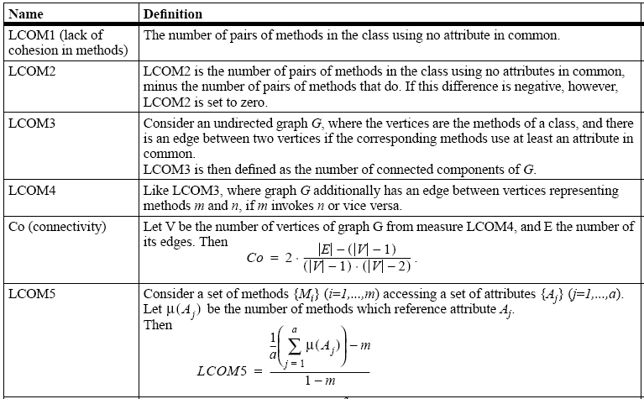
Some other cohesion metrics

Slide 46
Class Size
CS
Total number of operations (inherited, private, public)
Number of attributes (inherited, private, public)
May be an indication of too much responsibility for a class

Slide 47
Number of Operations Overridden
NOO
A large number for NOO indicates possible problems with the design
Poor abstraction in inheritance hierarchy

Slide 48
Number of Operations Added
NOA
The number of operations added by a subclass
As operations are added it is farther away from super class
As depth increases NOA should decrease

Slide 49
Method Inheritance Factor
MIF = .
M_{i}(C_{i}) is the number of methods inherited and not overridden in C_{i}
M_{a}(C_{i}) is the number of methods that can be invoked with C_{i}
M_{d}(C_{i}) is the number of methods declared in C_{i}

Slide 50
MIF
M_{a}(C_{i}) = M_{d}(C_{i}) + M_{i}(C_{i})
All that can be invoked = new or overloaded + things inherited
MIF is [0,1]
MIF near 1 means little specialization
MIF near 0 means large change

Slide 51
Coupling Factor
CF= .
is_client(x,y) = 1 iff a relationship exists between the client class and the server class. 0 otherwise
(TC²-TC) is the total number of relationships possible
CF is [0,1] with 1 meaning high coupling

Slide 52
Polymorphism Factor
PF = .
Mn() is the number of new methods
Mo() is the number of overriding methods
DC() number of descendent classes of a base class
The number of methods that redefines inherited methods, divided by maximum number of possible distinct polymorphic situations

Slide 53
Operational Oriented Metrics
Average operation size (LOC, volume)
Number of messages sent by an operator
Operation complexity – cyclomatic
Average number of parameters/operation
Larger the number the more complex the collaboration

Slide 54
Encapsulation
Lack of cohesion
Percent public and protected
Public access to data members

Slide 55
Inheritance
Number of root classes
Fan in – multiple inheritance
NOC, DIT, etc.

Slide 56
Metric tools
McCabe & Associates ( founded by Tom McCabe, Sr.)
The Visual Quality ToolSet
The Visual Testing ToolSet
The Visual Reengineering ToolSet
Metrics calculated
McCabe Cyclomatic Complexity
McCabe Essential Complexity
Module Design Complexity
Integration Complexity
Lines of Code
Halstead

Slide 57
CCCC
A metric analyser C, C++, Java, Ada-83, and Ada-95 (by Tim Littlefair of Edith Cowan University, Australia)
Metrics calculated
Lines Of Code (LOC)
McCabe’s cyclomatic complexity
C&K suite (WMC, NOC, DIT, CBO)
Generates HTML and XML reports
freely available at http://cccc.sourceforge.net/

Slide 58
Jmetric
OO metric calculation tool for Java code (by Cain and Vasa for a project at COTAR, Australia)
Requires Java 1.2 (or JDK 1.1.6 with special extensions)
Metrics
Lines Of Code per class (LOC)
Cyclomatic complexity
LCOM (by Henderson-Seller)
Availability
is distributed under GPL
http://www.it.swin.edu.au/projects/jmetric/products/jmetric/

Slide 59
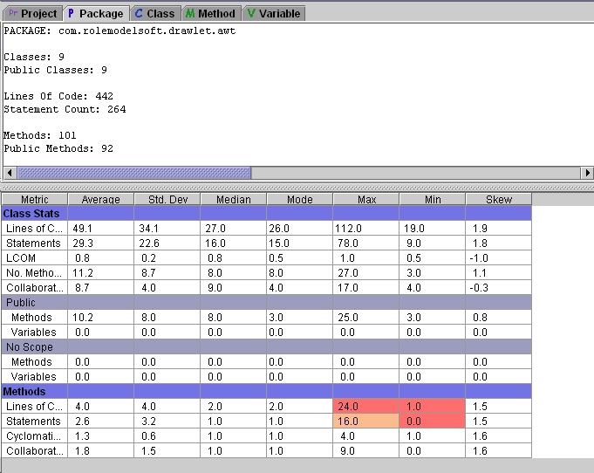
JMetric tool result

Slide 60
GEN++ (University of California, Davis and Bell Laboratories)
GEN++ is an application-generator for creating code analyzers for C++ programs
simplifies the task of creating analysis tools for the C++
several tools have been created with GEN++, and come with the package
these can both be used directly, and as a springboard for other applications
Freely available
http://www.cs.ucdavis.edu/~devanbu/genp/down-red.html

Slide 61
More tools on Internet
A Source of Information for Mission Critical Software Systems, Management Processes, and Strategies http://www.niwotridge.com/Resources/PM-SWEResources/SWTools.htm
Defense Software Collaborators (by DACS) http://www.thedacs.com/databases/url/key.hts?keycode=3 http://www.qucis.queensu.ca/Software-Engineering/toolcat.html#label208
Object-oriented metrics http://me.in-berlin.de/~socrates/oo_metrics.html
Software Metrics Sites on the Web (Thomas Fetcke)
Metrics tools for C/C++ (Christofer Lott) http://www.chris-lott.org/resources/cmetrics/

Slide 62
Software Cost Estimation
Two techniques:
Experience-based techniques. The estimate of future effort requirements is based on the manager’s experience of past projects and the application domain.
Algorithmic cost modeling. In this approach, a formulaic approach is used to compute the project effort based on estimates of product attributes, such as size, and process characteristics, such as experience of staff involved
If the initial estimate of effort required is x months of effort, they found that the range may be from 0.25x to 4x of the actual effort as measured when the system was delivered [Boehm et al., 1995]

Slide 63
Algorithmic Cost Modeling
Uses a mathematical formula to predict project costs based on estimates of the project size; the type of software being developed; and other team, process, and product factors.
Boehm et al. (2000):
A is a constant factor which depends on local organizational practices and the type of software that is developed.
Size may be either an assessment of the code size of the software or a functionality estimate expressed in function or application points.
The value of exponent B usually lies between 1 and 1.5.
M is a multiplier made by combining process, product, and development attributes, such as the dependability requirements for the software and the experience of the development team.
Effort = A * Size^{B} * M

Slide 64
Algorithmic Cost Modeling
The two problems:
It is often difficult to estimate Size at an early stage in a project, when only the specification is available. Function-point and application-point estimates are easier to produce than estimates of code size but are still often inaccurate.
The estimates of the factors contributing to B and M are subjective. Estimates vary from one person to another, depending on their background and experience of the type of system that is being developed.

Slide 65
COCOMO II Modeling
COnstructive COst MOdel.
COCOMO II was developed from earlier COCOMO cost estimation models, which were largely based on original code development [Boehm, 1981; Boehm and Royce, 1989]
Have been proposed to help estimate the effort, schedule, and costs of a software project.
Well-documented and nonproprietary estimation model.
Support spiral model and more modern approaches to software development, such as rapid development using dynamic languages,
Development by component composition, and use of database programming

Slide 66
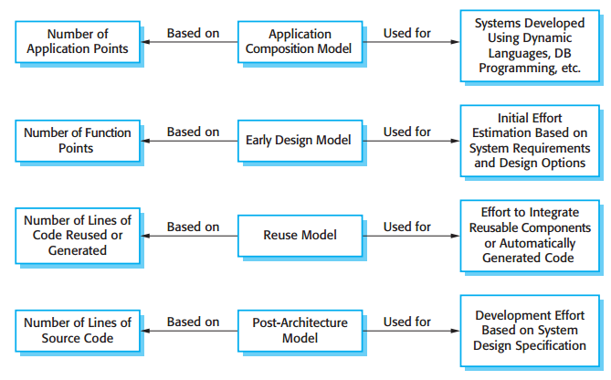
COCOMO II Modeling

Slide 67
COCOMO II Modeling
An application-composition model. This models the effort required to develop systems that are created from reusable components, scripting, or database programming.
An early design model. This model is used during early stages of the system design after the requirements have been established, but design has not yet started.
A reuse model. This model is used to compute the effort required to integrate reusable components and/or automatically generated program code.
A post-architecture model. Once the system architecture has been designed, a more accurate estimate of the software size can be made.

Slide 68
Application composition model
Supports prototyping projects and projects where there is extensive reuse.
Based on standard estimates of developer productivity in application (object) points/month.
Takes CASE tool use into account.
Formula is
PM = ( NAP × (1 - %reuse/100 ) ) / PROD
PM is the effort in person-months, NAP is the number of application points and PROD is the productivity.

Slide 69
Application-point productivity
Developer’s experience and capability | Very low | Low | Nominal | High | Very high
ICASE maturity and capability | Very low | Low | Nominal | High | Very high
PROD (NAP/month) | 4 | 7 | 13 | 25 | 50

Slide 70
Early design model
Estimates can be made after the requirements have been agreed.
Based on a standard formula for algorithmic models
PM = A × Size^{B} × M where
M = PERS × RCPX × RUSE × PDIF × PREX × FCIL × SCED;
A = 2.94 in initial calibration, Size in KLOC, B varies from 1.1 to 1.24 depending on novelty of the project, development flexibility, risk management approaches and the process maturity.

Slide 71
Multipliers
Multipliers reflect the capability of the developers, the non-functional requirements, the familiarity with the development platform, etc.
RCPX - product reliability and complexity;
RUSE - the reuse required;
PDIF - platform difficulty;
PREX - personnel experience;
PERS - personnel capability;
SCED - required schedule;
FCIL - the team support facilities.

Slide 72
The reuse model
Takes into account black-box code that is reused without change and code that has to be adapted to integrate it with new code.
There are two versions:
Black-box reuse where code is not modified. An effort estimate (PM) is computed.
White-box reuse where code is modified. A size estimate equivalent to the number of lines of new source code is computed. This then adjusts the size estimate for new code.

Slide 73
Reuse model estimates 1
For generated code:
PM = (ASLOC * AT/100)/ATPROD
ASLOC is the number of lines of generated code
AT is the percentage of code automatically generated.
ATPROD is the productivity of engineers in integrating this code.

Slide 74
Reuse model estimates 2
When code has to be understood and integrated:
ESLOC = ASLOC * (1-AT/100) * AAM.
ASLOC and AT as before.
AAM is the adaptation adjustment multiplier computed from the costs of changing the reused code, the costs of understanding how to integrate the code and the costs of reuse decision making.

Slide 75
Post-architecture level
Uses the same formula as the early design model but with 17 rather than 7 associated multipliers.
The code size is estimated as:
Number of lines of new code to be developed;
Estimate of equivalent number of lines of new code computed using the reuse model;
An estimate of the number of lines of code that have to be modified according to requirements changes.

Slide 76
The exponent term
This depends on 5 scale factors (see next slide). Their sum/100 is added to 1.01
A company takes on a project in a new domain. The client has not defined the process to be used and has not allowed time for risk analysis. The company has a CMM level 2 rating.
Precedenteness - new project (4)
Development flexibility - no client involvement - Very high (1)
Architecture/risk resolution - No risk analysis - V. Low .(5)
Team cohesion - new team - nominal (3)
Process maturity - some control - nominal (3)
Scale factor is therefore 1.17.

Slide 77
Scale factors used in the exponent computation in the post-architecture model
Scale factor | Explanation
Precedentedness | Reflects the previous experience of the organization with this type of project. Very low means no previous experience; extra-high means that the organization is completely familiar with this application domain.
Development flexibility | Reflects the degree of flexibility in the development process. Very low means a prescribed process is used; extra-high means that the client sets only general goals.
Architecture/risk resolution | Reflects the extent of risk analysis carried out. Very low means little analysis; extra-high means a complete and thorough risk analysis.
Team cohesion | Reflects how well the development team knows each other and work together. Very low means very difficult interactions; extra-high means an integrated and effective team with no communication problems.
Process maturity | Reflects the process maturity of the organization. The computation of this value depends on the CMM Maturity Questionnaire, but an estimate can be achieved by subtracting the CMM process maturity level from 5.

Slide 78
Multipliers
Product attributes
Concerned with required characteristics of the software product being developed.
Computer attributes
Constraints imposed on the software by the hardware platform.
Personnel attributes
Multipliers that take the experience and capabilities of the people working on the project into account.
Project attributes
Concerned with the particular characteristics of the software development project.

Slide 79
The effect of cost drivers on effort estimates
Exponent value | 1.17
System size (including factors for reuse and requirements volatility) | 128,000 DSI
Initial COCOMO estimate without cost drivers | 730 person-months
Reliability | Very high, multiplier = 1.39
Complexity | Very high, multiplier = 1.3
Memory constraint | High, multiplier = 1.21
Tool use | Low, multiplier = 1.12
Schedule | Accelerated, multiplier = 1.29
Adjusted COCOMO estimate | 2,306 person-months

Slide 80
The effect of cost drivers on effort estimates
Exponent value | 1.17
Reliability | Very low, multiplier = 0.75
Complexity | Very low, multiplier = 0.75
Memory constraint | None, multiplier = 1
Tool use | Very high, multiplier = 0.72
Schedule | Normal, multiplier = 1
Adjusted COCOMO estimate | 295 person-months

Slide 81
References
Roger S. Pressman, 2010, Software Engineering: A Practitioner’s Approach 7th edition, McGraw-Hill.
Ian Sommerville, 2011, Software Engineering 9th edition, Addison-Wesley.
Boehm, B. 2000. “COCOMO II Model Definition Manual”. Center for Software Engineering, University of Southern California. http://csse.usc.edu/csse/research/COCOMOII/cocomo2000.0/CII_modelman2000.0.pdf.
Other references

Slide 82
Thanks
Achmad Solichin, S.Kom, M.T.I
achmatim@gmail.com
Twitter: @achmatim
Facebook: facebook.com/achmatim
Web: http://achmatim.net

